Slide 1
Python Course for Physicists (And everyone else!) Chunk 8: 1D Numpy Arrays
By Jonathan Bollig
09.10.2025

Slide 2
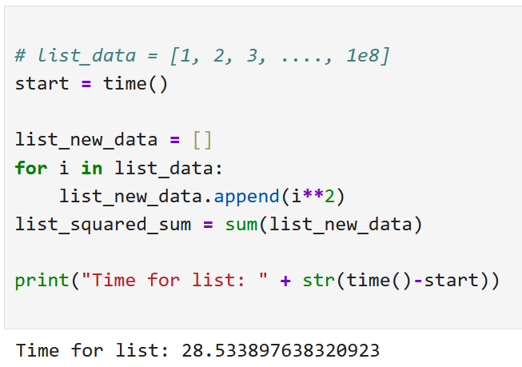
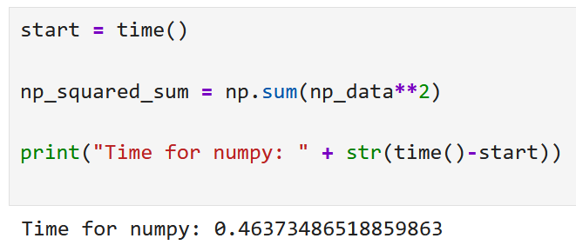
Numpy: Numerical Python; →Lists but much better
Problem: loops and lists are “slow”: → Example: square 100 000 000 numbers and square them → 28 seconds
Solution: Using C-code in python → 0.5 seconds → Numpy is typically 10 – 100 x faster
Bonus: Cleaner, easier to read code

Slide 3
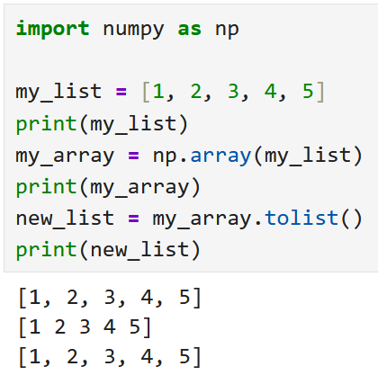
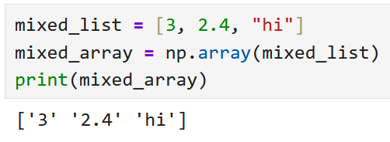
Live Coding: Creating Arrays
Convention!
1. Step: import numpy as np
Converting “list → array”: np.array():
Converting “array → list”: array.tolist() :
Careful! Only one data type:
Nested lists: Only when all elements have lists of same length.

Slide 4
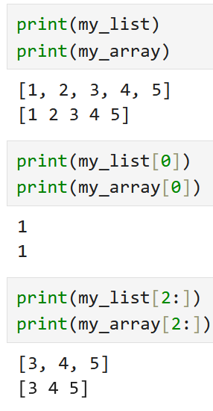
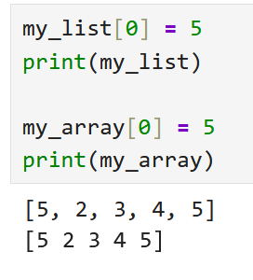
Live Coding: Behavior – Similarities
Printing and slicing behave the same
Setting values stays the same:

Slide 5
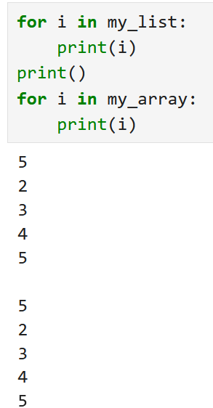
Live Coding: Behavior – Similarities
Looping: Be warned: Looping is slow

Slide 6
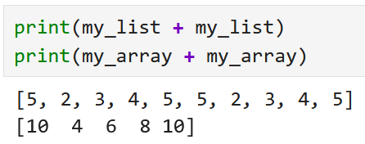
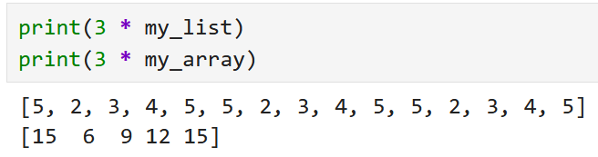
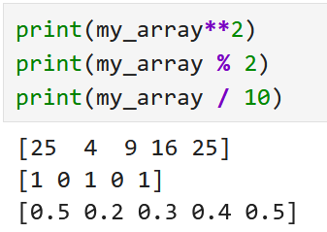
Live Coding: Behavior - Differences
Adding lists:
Multiplying lists:
(Almost ?) All mathematical operators work element-wise! → Lists need same shape!

Slide 7
Live Coding: Array Generation Functions
Arrays can be created by other means than passing a list
Direct ways:
np.arange(start, stop, step): [start, start + step, start + 2* step, … ] until . you reach stop (excluding)
np.linspace(start, stop, n): Array of length n from start to stop, equally . Spaced
np.zeros(n) / np.ones(n): Array filled with 0 / 1 of length n.
np.full(n, what): Array of length n, filled with „what“

Slide 8
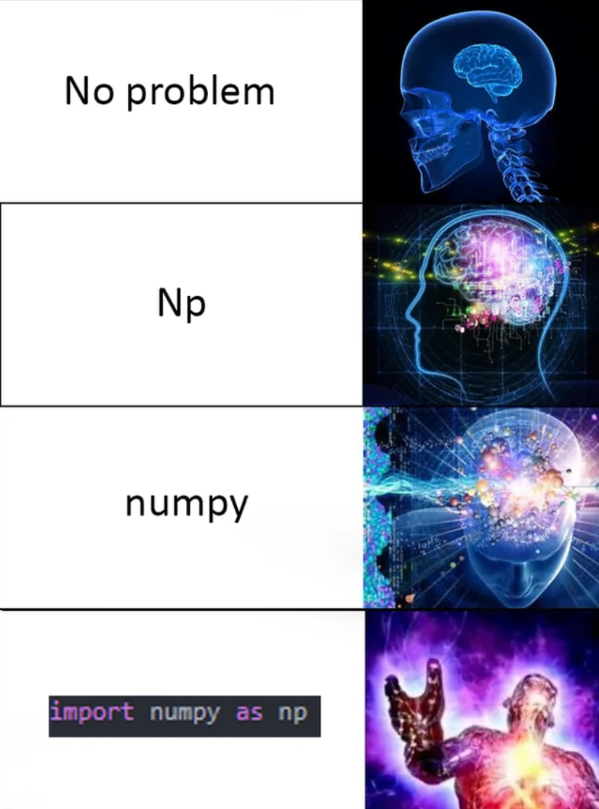
Good Luck with your Tasks ☺
[https://www.reddit.com/r/ProgrammerHumor/comments/g6z7qm/no_problem/]

